Slide 1
A Woman's Worth
Jessica Knox
CIS 1020-035
04/23/2011
A Woman's Worth.docx

Slide 2
“You are beautiful, no matter what they say”
“You suppose you are the trouble, but you are the cure. You suppose that you are the lock on the door, but you are the key that opens it. It’s to bad that you want to be someone else, you don’t see your own face and your own beauty, yet, no face is more beautiful than yours.”~Rumi
Beauty is on the inside
All woman are beautiful
Accept who you are

Slide 3
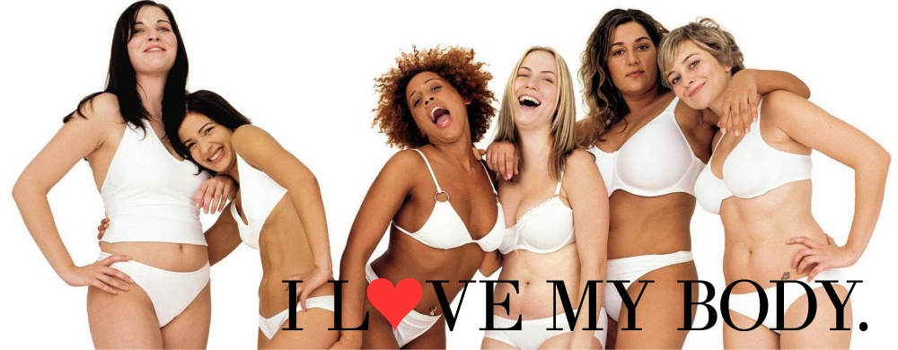
Ways to create a healthy body image

Slide 4


Slide 5
Make a list of woman you admire
Who do you admire about her?
What do you admire her for?
What qualities do you hope someone would admire you for?
Notes:
Slides 5, 7, and 9 are information gathered from teenadvisor.com

Slide 6


Slide 7
“Question the motives of the fashion industry”
Remember they are out to make money!
The best way to do that is to make you feel bad about yourself.
Then you buy there products.

Slide 8
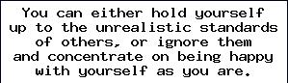

Slide 9
“Concentrate on things you do well”
How do you like to spend your free time?
What are your hobbies?
What are you most interested in?

Slide 10


Slide 11
“Break the Barriers”
Don’t be afraid to be yourself.
Start new fashion trends.
Be the boss of you.

