Slide 1
What Is A Family?

Slide 2
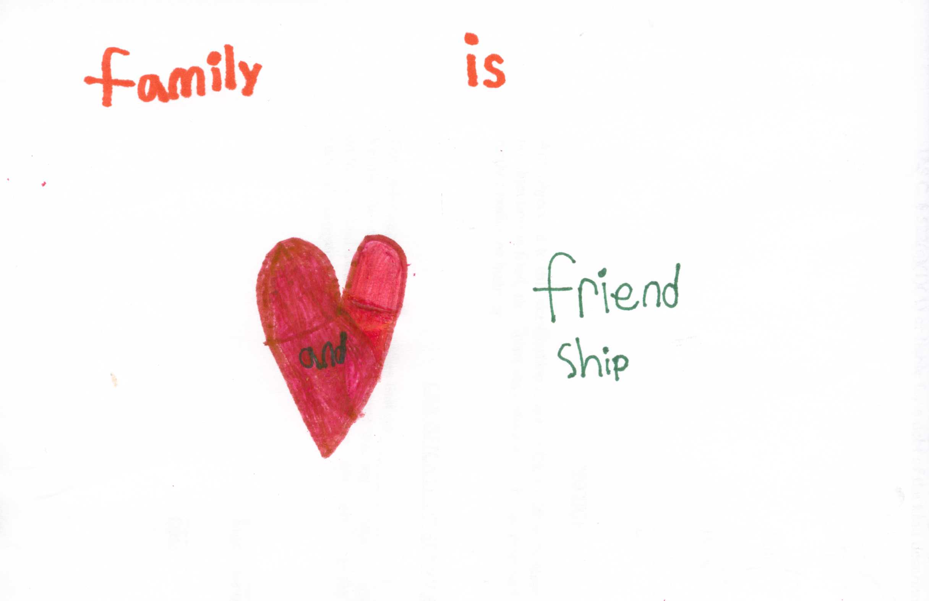
Damion
10 yrs old

Slide 3
Jessica
34 Yrs old
My Love, My Lesson, My Heart, My Happiness, My Strength, My Future, My Weakness, My Friendship, My Tomorrow, My Sadness, My Creation, My Good, My Stress, My Laughter, My Tears, My Crazy, My Dreams, My Comfort, My Hopes, My Fears, My Thoughts, My Worries, My Celebrations, My Constant, My Heartache, My Embarrassing, My Circle, My Promises, My Forgiveness, My Beginning, My Best, My Passion, My Identity, My Worst, My Favorite, My Faith, My Everything, My Heaven, My Cares, My Frustrations, My Sweetness, My Evil, My Greatness, My Forever, My End, My Life

Slide 4
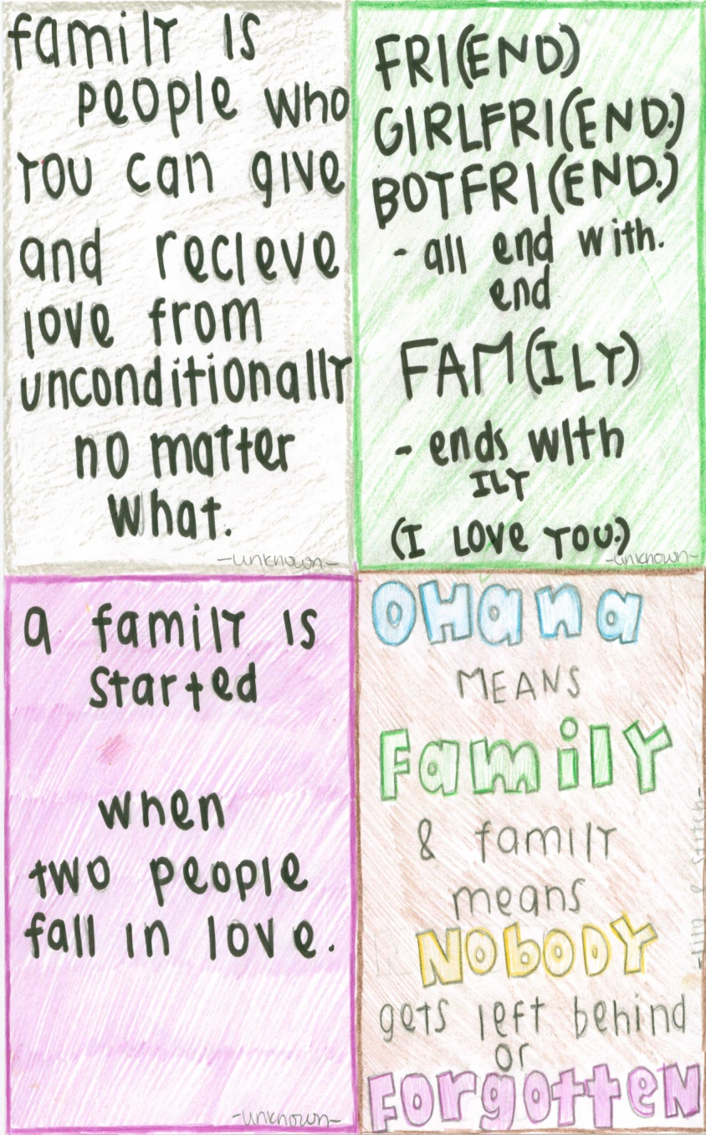
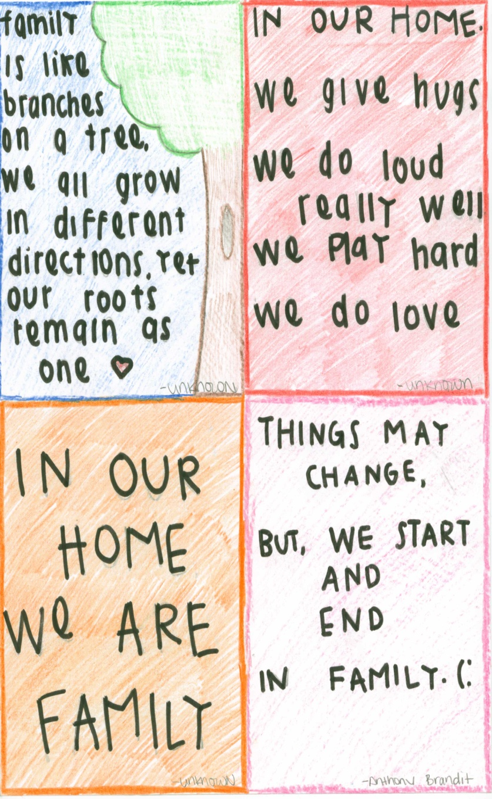
Alyssa
16 yrs old

Slide 5
Family is strength, reason, value, and purpose. It is what keeps us going and what we search for in times when we are happy, sad, alone or fearful. No matter what the situation is, a family is what gives us life. A family is who we can depend on through thick and thin, high and low.
Lindsay
27 yrs old

Slide 6
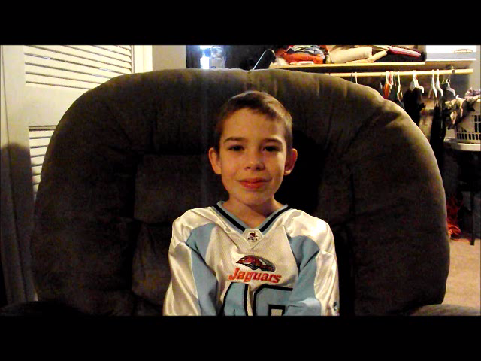
Damion

Slide 7
Family
A family is people you have known you whole life
A family is where trust, hope, and happiness fits in
A family is where you keep each others heart with you all the time.
Jay
13 yrs old

Slide 8
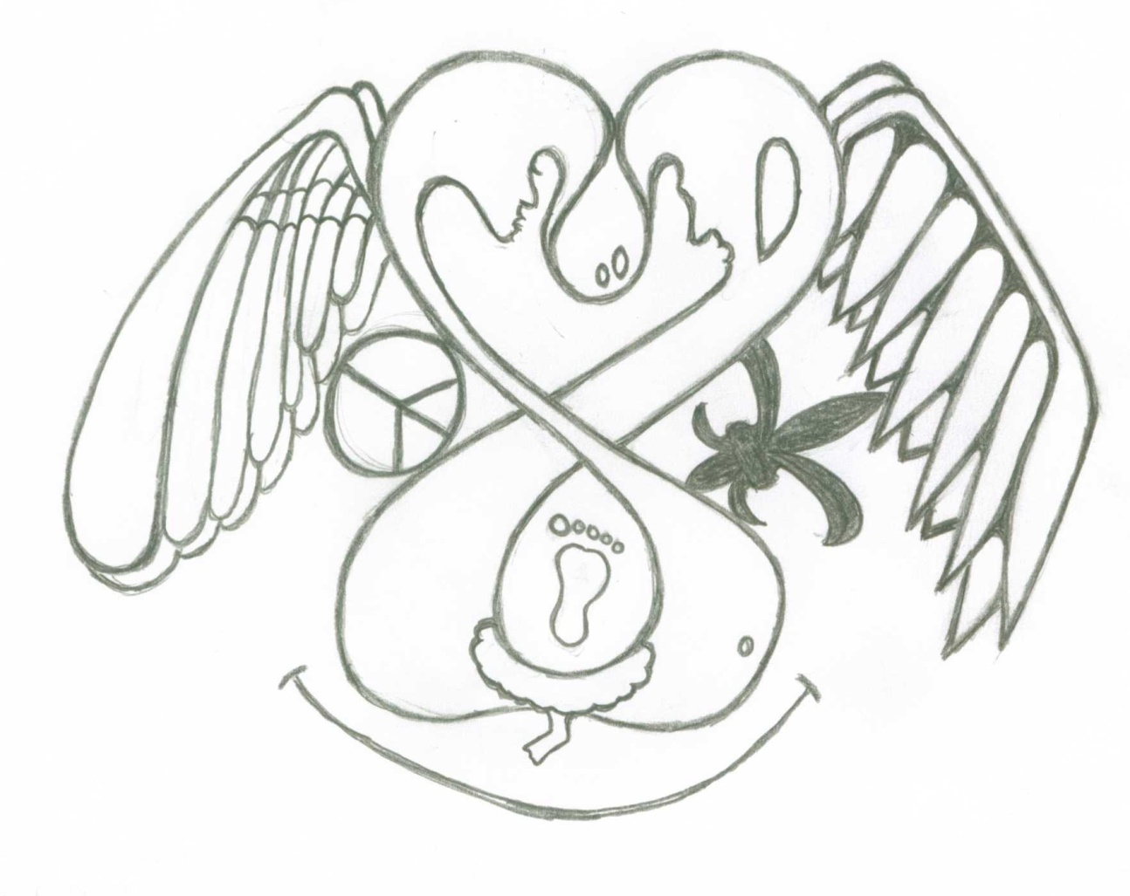
Jethro
35 yrs old

Slide 9
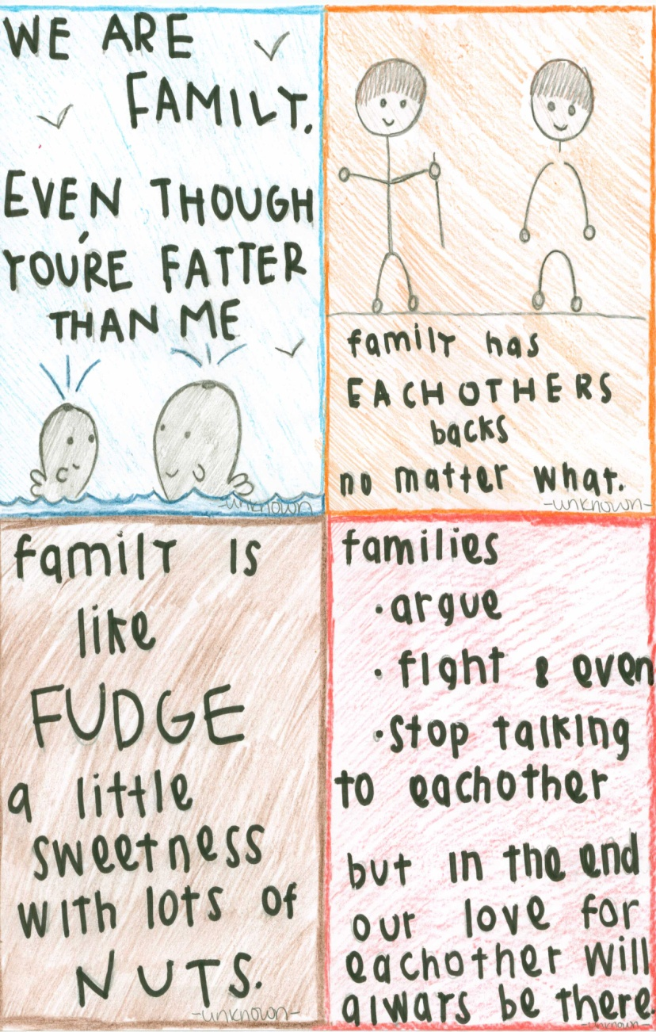
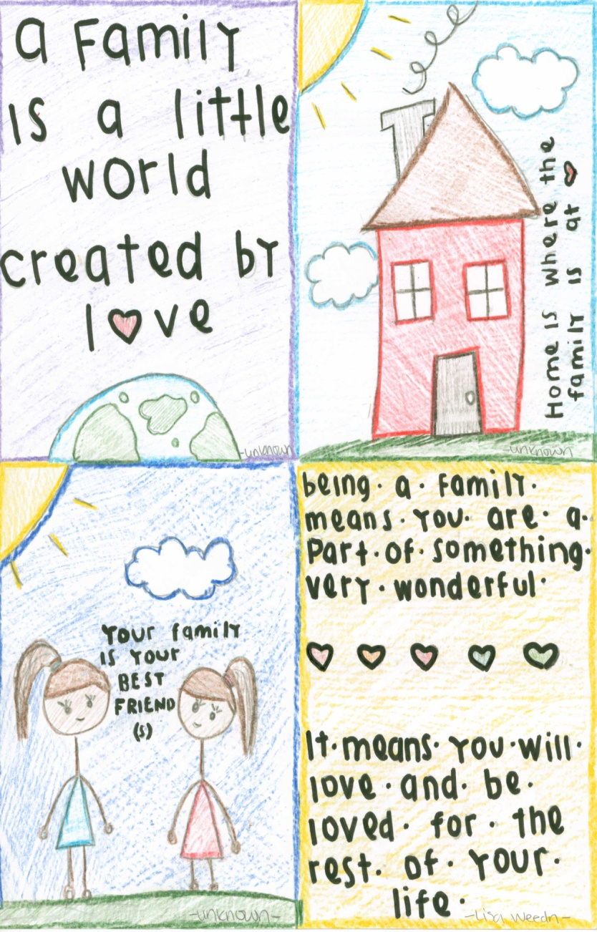
Alyssa
16 yrs old

Slide 10
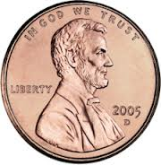
Janie
27 years old
Family is like a penny, because you feel like a penny has no value to it but then you find yourself searching through your purse, because you NEED that penny; without that penny you won't be able to pay for your purchase. A penny has huge value to it, you have so many of them just like family members and you always need a penny even when you think you don't, just like your family. You use your penny to make a wish in a fountain and then hope for your dreams to come true just like you tell your family all your hopes and dreams and they help you accomplish those things. A penny also has the coolest president on it so it will remind you that you have the coolest family! So, family is like a penny, you don't need much but it will get you to where you need to go :)

Slide 11
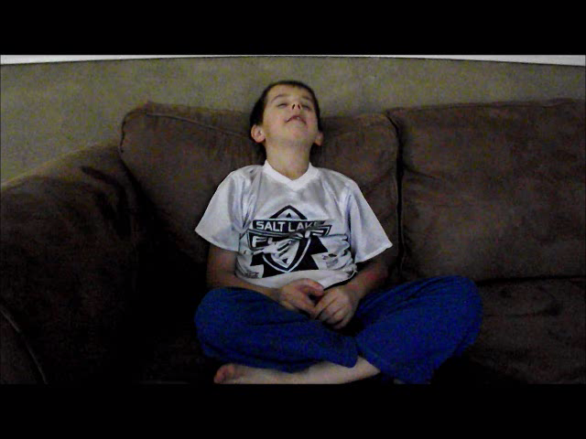
Lucas – 7 yrs old

